Slide 1
Clean Code

Slide 2
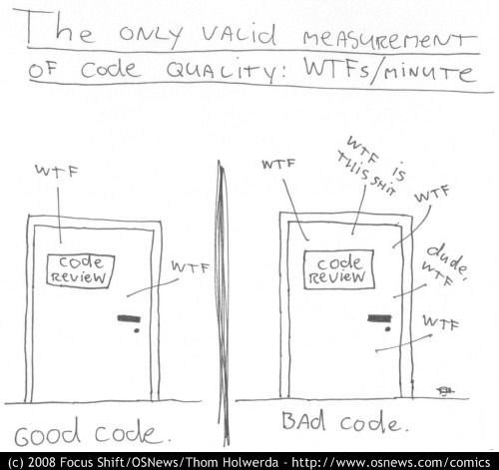
Good Code vs Bad Code

Slide 3
What is Clean Code
Elegant
Efficient
Pleasing
Graceful
Stylish
Minimal
Literate
Taken care of
Written with pride

Slide 4
The Boy Scout rule :Leave the campground cleaner than you found it.
The Clean Code rule : Leave the code cleaner than you found it.
By following this rule, code gets better over time.

Slide 5
Meaningful Names
Use intention revealing names
int d // wtf ?
int m_iHwWindowHandle // wtf ?
int loopCounter
int windowHandle
Avoid Disinformation
No s**t Sherlock. I want to code, not solve puzzles
Avoid inconsistent spelling.
Use Pronounceable Names
txtPwordCfrm ( go on say it !!)
passwordConfirmTextBox

Slide 6
Meaningful Names
Avoid mental mapping don’t make me think
not-null=“true”
not-null=“false”
not-null=“wtf?”
null=“true” allow-nulls=“false” //easy …
Avoid single letter variable names
Use precious brain time to solve the problem, not solve puzzles in the code
Use nouns in class names, don’t use verbs

Slide 7
Meaningful Names
Method names should have verbs
should, get , is, has
Don’t be cute
whack(), kill(), finger(), mount(), hopeORACSaves(), diediedie()
Pick one word per concept
Don’t use the same word for different things
Be consistent. Add() always adds.
Use Problem Domain Names

Slide 8
Task 1
Rename variables in the Sudoku class.
Use Resharper only (F2)
Run tests frequently

Slide 9
Functions
Small
How small ?
Smaller than that
What’s the smallest function you can think of ?
That’s how small.

Slide 10
Functions
Avoid more than one if/else in a function
Should not be large enough to hold nested structures.
A function should not many indentation levels.
Do one thing. Do it well . Should do it only

Slide 11
Task 2
Use Resharper Extract method (Ctrl + M)
Use Ctrl +W to select code. Ctrl +Shift + W to unselect.
Repeating the shortcut expands the scope of the selected code.
Extract smaller and smaller methods.
Remember naming !!.
Re-use functions where possible. Remove duplication.

Slide 12
Functions
One Level of Abstraction per Function
buildPage(){
buildHeader();
buildBody();
}
buildHeader(){
buildMetaTags()
buildTitle()
}
buildMetaTag(){
writer.Render(“<meta />”)
}
buildTitle(){
writer.Render(“<title />”)
}

Slide 13
The Step Down rule : should read from top to bottom
buildHtml(){ beginBody(); buildBody(); endBody(); } beginBody(){} buildBody(){} endBody(){} | beginBody(){} buildHtml(){ beginBody(); buildBody(); endBody(); } endBody(){} buildBody(){}

Slide 14
Task 3
Use the ReSharper File Structure window (Ctrl + F11)
Re-arrange and rename methods.
Extract new methods if needed.
Remove duplication

Slide 15
Function Arguments
Ideally zero arguments
One, two are ok
Avoid three or more arguments
Have no side effects
Promise to do one thing but don’t do other things
Command Query Separation
Do something or answer something not both

Slide 16
The Law of Demeter
A method f of class C should only call
C
an object created by f
An object passed as an argument to f
An object held in an instance variable of C

Slide 17
Task 4
Rename function arguments (F2 ).
Rearrange them (Ctrl + F6). Hint : cursor should be on the function.
Extract more functions to ideally have only one argument.
Remember the Law of Demeter.
Remove duplication.

Slide 18
Comments
Are bad
Explain yourself in code, not comments
If you have to comment it, extract into a function and give a descriptive name
Code that you have to comment should be a function
Don’t mumble.
No TODOs or //change before going to production
Don’t comment code, delete it. Use version control

Slide 19
Task 5
See any comments ?
Do you need to add any ?
Turn code that needs commenting into functions or rename functions

Slide 20
Classes
First rule of classes is that they should be small
Second rule of classes is that they should be smaller than that
How small ?
Count responsibilities
How many things is it doing ?

Slide 21
Single Responsibility Principle
A class should have only one reason to change
What will make the class change ?
Note what can cause the Sudoku class to change .

Slide 22
Task 6
Note the reasons for change in the Sudoku class.
Look at methods that seem to belong together and have one reason to change.
Move these methods to a new class.
Extract new methods if necessary.
Fix the code to compile and pass tests.
Take small steps. Remove duplication as you go

Slide 23
Task 7
Remove if statements in the code

Slide 24
Emergence
Look at the Sudoku class
How has it changed ?
Is it cleaner ?
Is it more readable ?

Slide 25
A design is simple
If it runs all tests
If it contains no duplication
If it expresses the intent of the programmer
If it minimizes the number of classes and methods
Look back at your code. Is it simple ?

Slide 26
Successive refinement
By applying simple refactoring, cleaner code emerges over time.
You can’t fix it all in big step.
Be patient, take small steps.

Slide 27
Boy Scout Tips
Let ReSharper do the work
Keep the Resharper bar green at all times
Run tests
Do small refactoring where you can
Rename , extract method and move method.
Repeat endlessly

